Slide 1

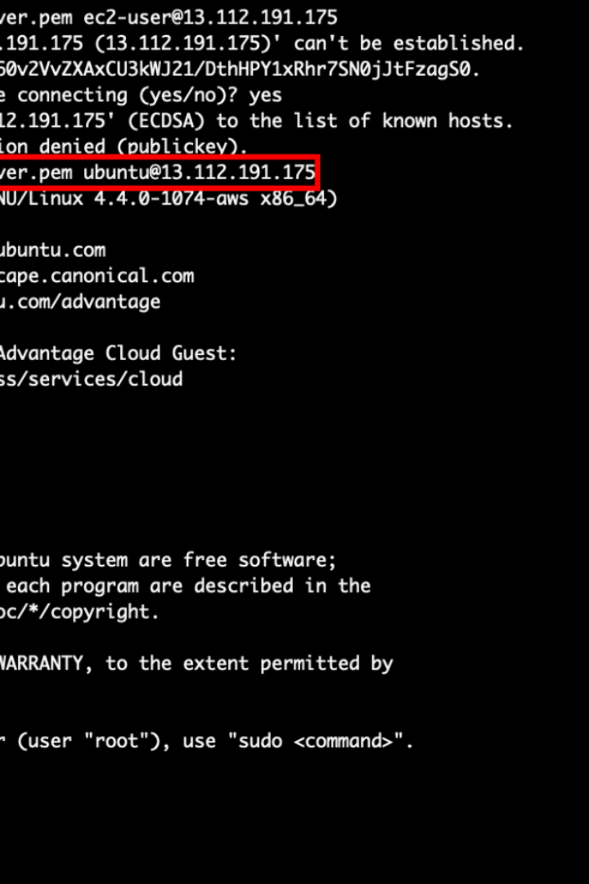


Linux File Handling Utilities
This document provides an overview of essential Linux file manipulation commands.
by Hemanth M

Slide 2
ls - List Files and Directories
The ls command is a fundamental utility for listing the contents of a directory. It displays filenames, directory names, and various attributes such as permissions and timestamps.
Description
Lists files and directories in the current directory.
Command
ls
Example
ls

Slide 3


cd - Change Directory
The cd command is used to navigate the file system by changing the current working directory. You specify the desired directory path as an argument, and your working directory is updated accordingly.
Description
Changes the current working directory.
Command
cd /path/to/directory
Example
cd /home/user/documents

Slide 4

pwd - Print Working Directory
The pwd command stands for "print working directory." It provides the full path to the directory you are currently working in. This is helpful for knowing your current location within the file system.
Description
Displays the current working directory.
Command
pwd
Example
pwd

Slide 5

mkdir - Create Directory
The mkdir command allows you to create a new directory with the specified name in the current working directory. Directories are used to organize and structure your file system.
Description
Creates a new directory.
Command
mkdir directory_name
Example
mkdir new_directory

Slide 6

rmdir - Remove Directory
The rmdir command is used to delete empty directories. It can only remove directories that have no files or subdirectories within them.
Description
Removes an empty directory.
Command
rmdir directory_name
Example
rmdir empty_directory

Slide 7

touch - Create or Update File
The touch command is versatile. It can create a new, empty file with the specified filename. If the file already exists, touch updates its access and modification timestamps, making it useful for managing timestamps on files.
Description
Creates an empty file or updates its timestamp.
Command
touch filename
Example
touch new_file.txt

Slide 8

cp - Copy Files and Directories
The cp command creates copies of files or directories. It takes two arguments: the source file or directory to be copied and the destination where the copy should be placed.
Description
Copies files and directories.
Command
cp source_file destination
Example
cp file1.txt file2.txt

Slide 9
mv - Move or Rename Files/Directories
The mv command is versatile; it can rename files or move them to different directories. It's a powerful tool for organizing and managing files.
Description
Moves or renames files and directories.
Command
mv old_name new_name
Example
mv file.txt new_file.txt

Slide 10
rm - Remove Files/Directories
The rm command is used for removing files and directories. Use it with caution, as it is a permanent operation.
Description
Removes files and directories.
Command
rm filename
Example
rm unwanted_file.txt

Slide 11

cat - Display File Contents
The cat command displays the entire contents of a text file in the terminal. It's helpful for quickly viewing the contents of small to medium-sized files.
Description
Concatenates and displays file contents.
Command
cat filename
Example
cat file.txt

Slide 12

more and less - View File Page by Page
The more and less commands allow you to view large text files one page at a time, making it easier to read and navigate through lengthy documents.
Description (More)
Displays file content page by page.
Command (More)
more filename
Example (More)
more long_text_file.txt
Description (Less)
Displays file content page by page.
Command (Less)
less filename
Example (Less)
less long_text_file.txt

Slide 13

head and tail - View Beginning/End of File
The head and tail commands are useful for quickly peeking at the start or end of a file, making them valuable for log files and other lengthy documents.
Description (Head)
Displays the beginning of a file.
Command (Head)
head filename
Example (Head)
head document.txt
Description (Tail)
Displays the end of a file.
Command (Tail)
tail filename
Example (Tail)
tail log.txt

Slide 14
grep - Search for Patterns in Files
The grep command is a powerful text search utility. It scans the specified file for lines containing the specified pattern and prints matching lines to the terminal.
Description
Searches for patterns in files.
Command
grep pattern filename
Example
grep "error" log.txt

Slide 15

THANK YOU

